Slide 1
AGENCYCORE · BOARD REVIEW
June 2026 Product
Roadmap Review
Make the product stronger and more reliable, lift the quality of what it delivers, own the data it depends on, and build new features and workflows on top.
4
1
Jun → Aug 2026
Themes
Foundation
Timeline

Slide 2
RECENT PROGRESS · JUN 11 – 29, 2026
Product progress overview
Over the last two weeks we shipped steady, customer-facing reliability improvements across every part of the product.
259
CRM
Headhunter
Smoother record creation, a cleaner interface, and fewer bugs.
Better candidate discovery, more accurate contacts, and reliable exports.
improvements shipped
across the product, in two weeks
Outreach + search
Platform + data
More improvements are already underway for the weeks ahead.
More reliable email outreach and search, from start to delivery.
Faster, more reliable data behind the whole product.
Next: focus on the highest-impact customer-facing fixes first.
AgencyCore · Product Roadmap · June 2026
2

Slide 3
Roadmap overview
A foundation-first plan: we tackle these four themes in order across June to August, so each step builds on the one before it.
JUNE 2026
THEME 1
In progress
JUNE 2026
THEME 2
In progress
A stronger, more reliable product
Higher-quality results
A dependable foundation so the product stays fast and reliable as we grow.
Sharper, more accurate results plus a new buying-signals capability.
JULY 2026
THEME 3
Planned
AUGUST 2026
THEME 4
Planned
Own our data
New features and workflows
Our own company and people data, so we stop re-paying for what we already know.
New product features and automations built on the foundation and our own data.
AgencyCore · Product Roadmap · June 2026
3

Slide 4





THE CASE FOR CHANGE
Why we're fixing the foundation first
Today's product has three core limitations. A stronger foundation solves each one, and unlocks what we build next.
TODAY
WITH A STRONGER FOUNDATION
A dependable product customers can rely on every day.
Reliability falls short
The product can slow down or fail just when customers depend on it.
Accurate, trustworthy results that build customer confidence.
Results aren't accurate enough
We sometimes surface the wrong company or contact, which erodes trust.
Ship new features and capabilities much faster.
Too slow to innovate
Building and launching new capabilities takes too long today.
AgencyCore · Product Roadmap · June 2026
4

Slide 5
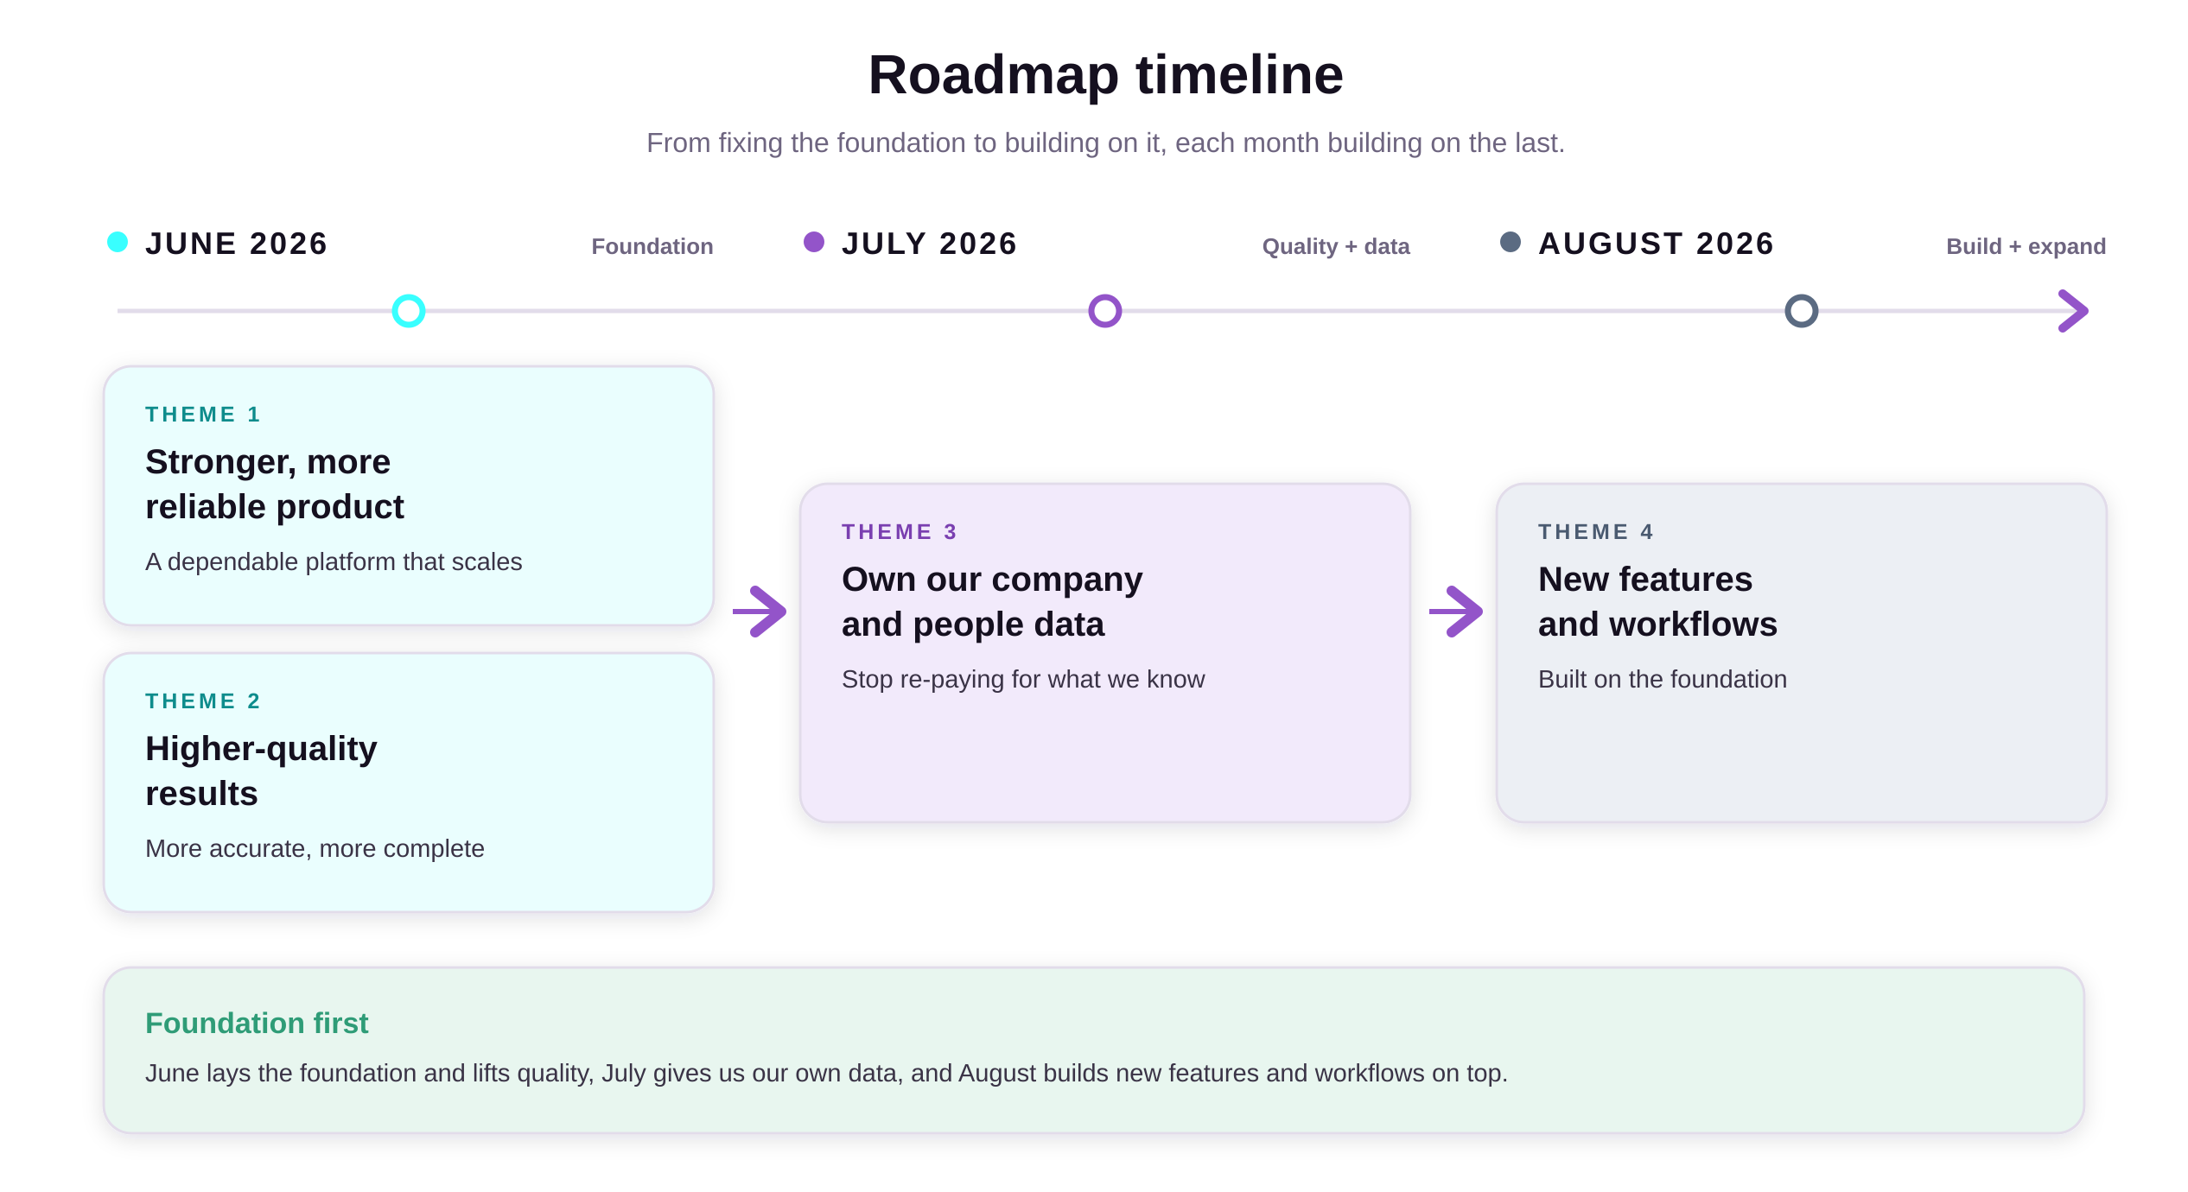
AgencyCore · Product Roadmap · June 2026
5

Slide 6
01
THEME 01 · Now · JUNE 2026
A stronger, more reliable product
As we grow, the product needs to stay fast and dependable. Today's setup can't guarantee that, so we are giving it a solid foundation of its own.
4
Reusable building blocks the foundation every new capability is built on
AgencyCore · Product Roadmap · June 2026
6

Slide 7
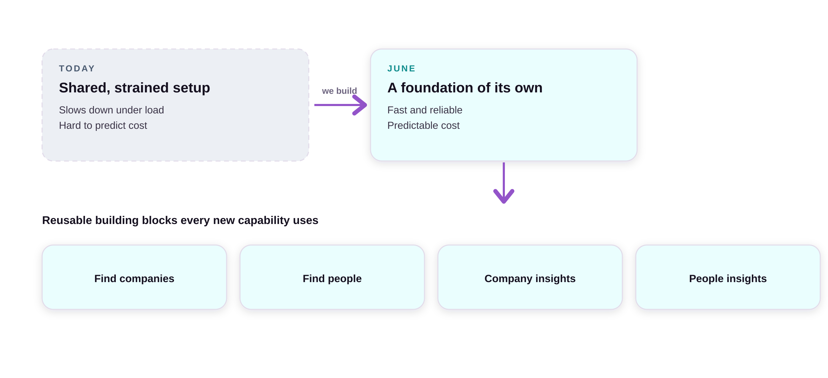
JUNE 2026
THEME 01
A stronger, more reliable product
1
Dependable and fast
The product stays fast and reliable for customers, even as usage grows.
2
Predictable cost
Every action has clear limits, so cost stays under control as we scale.
A dependable foundation, plus reusable building blocks that speed up everything we create next.
3
Reusable building blocks
A core set of building blocks that every new capability is assembled from.
AgencyCore · Product Roadmap · June 2026
7

Slide 8
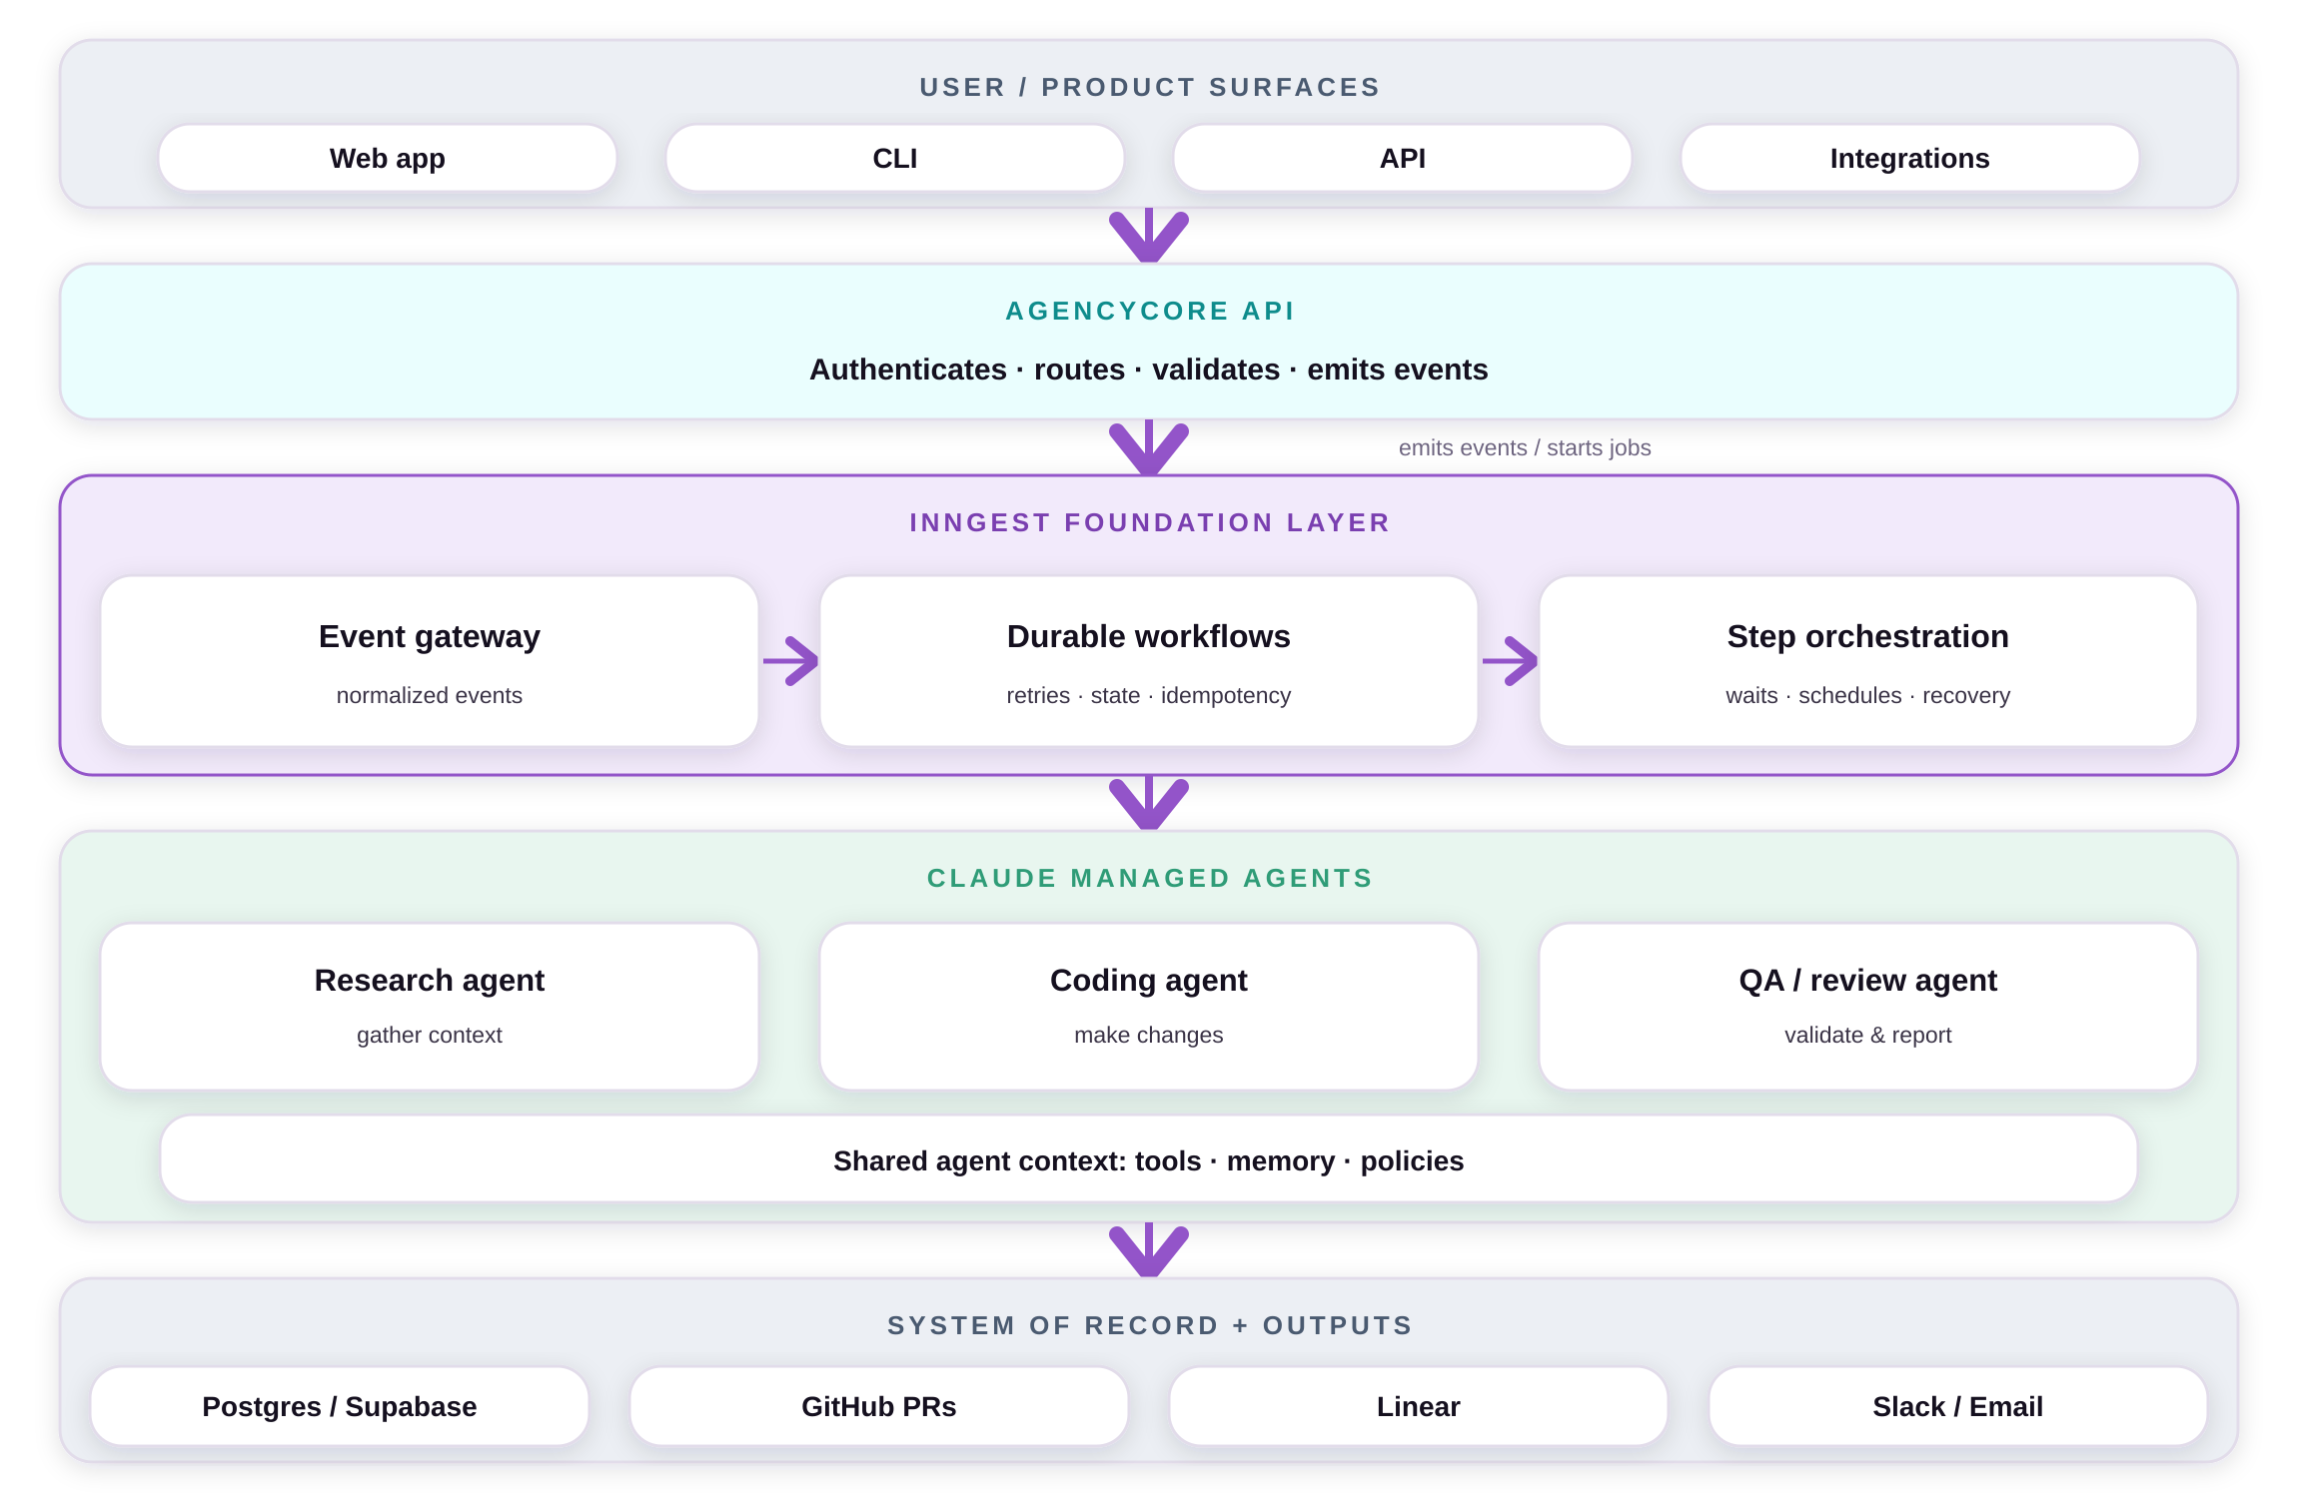
A DEEPER LOOK · THE FOUNDATION
Building a durable AI foundation layer
Inngest provides reliable workflow orchestration; Claude managed agents provide specialized execution.
A durable backbone
Inngest handles events, retries, schedules, waits, and recovery.
Specialized AI workers
Claude agents do research, coding, QA, and operational tasks.
A thin API
It authenticates, validates, and emits events, nothing more.
Observable long-running work
AI work moves out of request paths into tracked workflows.
Grounded and governed
Every agent action runs on shared context, tools, and policies.
AgencyCore · Product Roadmap · June 2026
8

Slide 9
02
THEME 02 · Now · JUNE 2026
Higher-quality results
The quality of our core results has plateaued. On the stronger foundation we rebuild them, broaden the data behind them, and add valuable new capabilities.
+1
New buying-signals capability spots the right moment to reach out
AgencyCore · Product Roadmap · June 2026
9

Slide 10
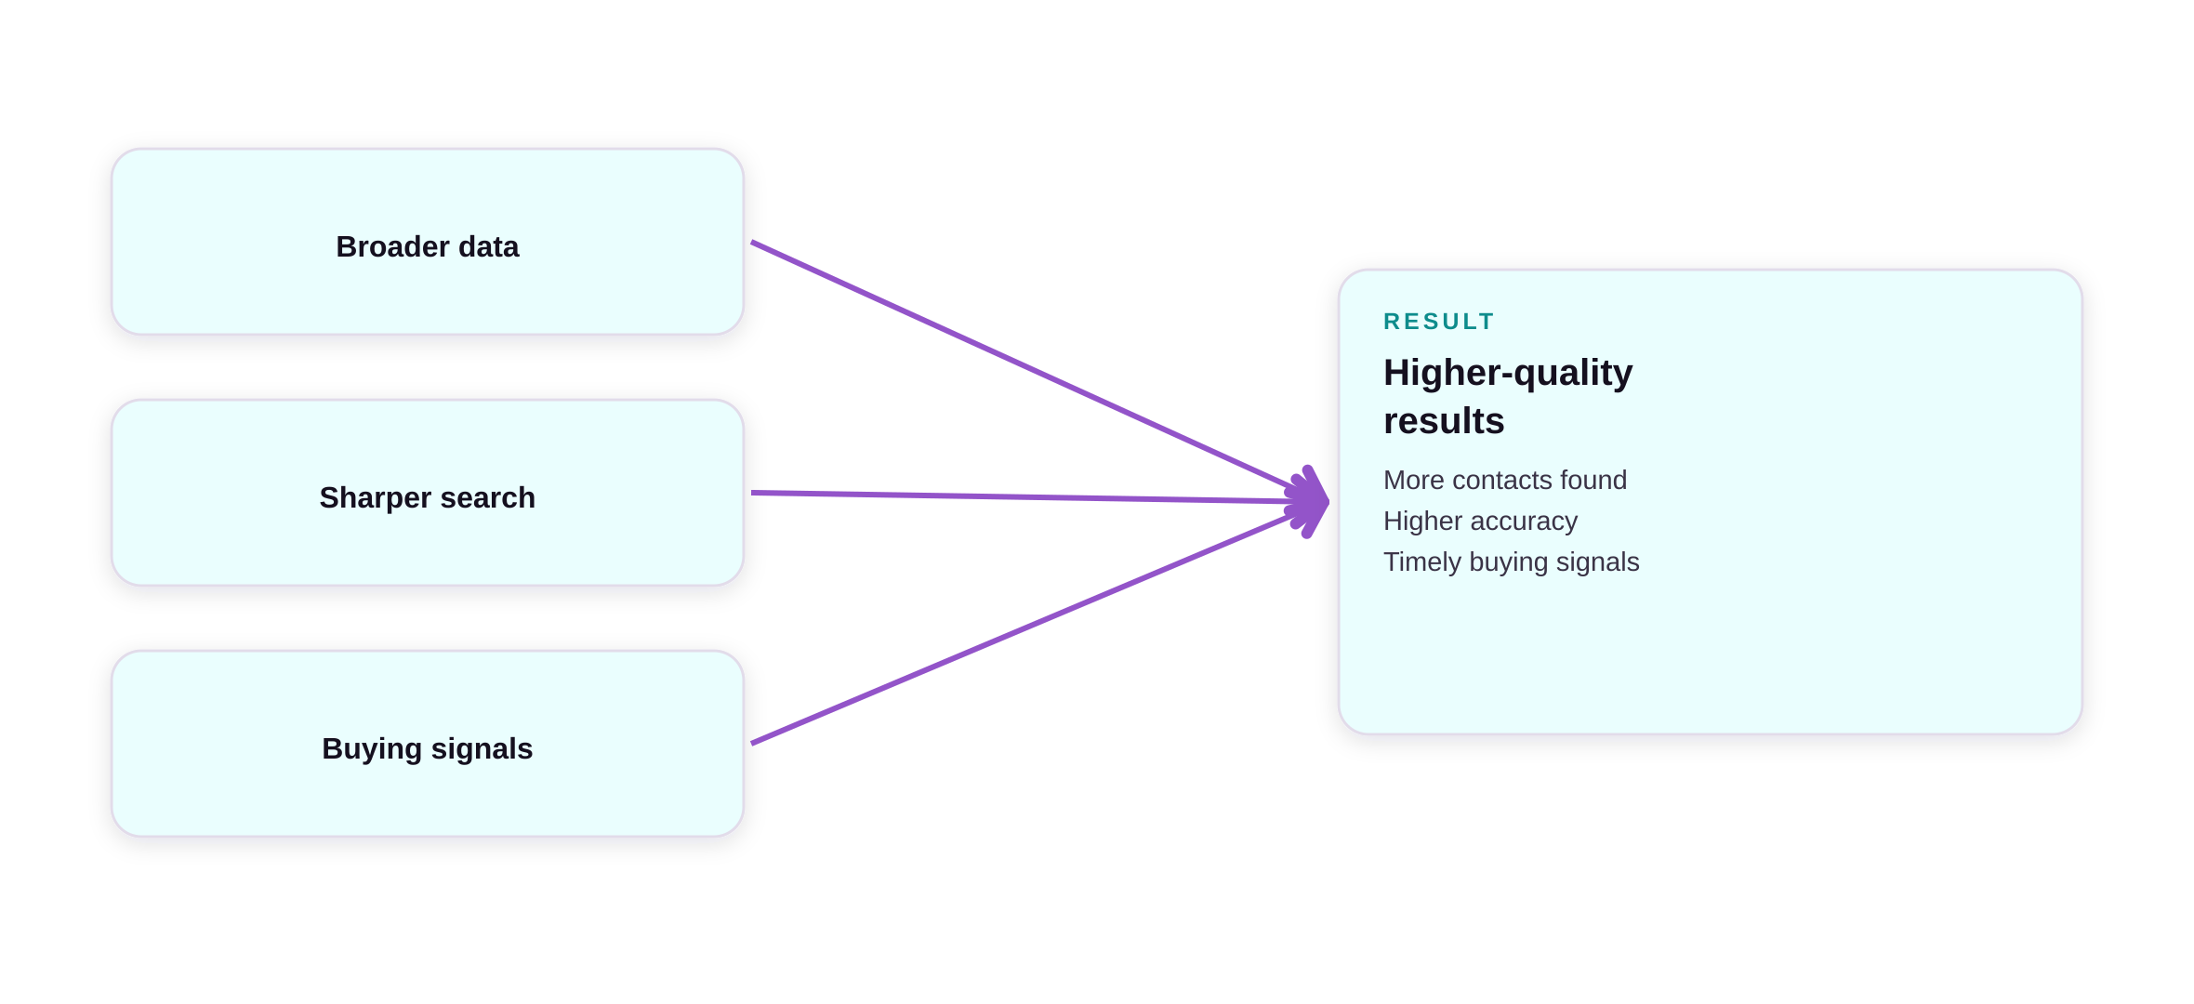
JUNE 2026
THEME 02
Higher-quality results
1
Sharper results
Our core search results are rebuilt to be more accurate and complete.
2
Broader data
More data behind every search means more contacts and higher accuracy.
Better data and rebuilt capabilities mean more contacts, higher accuracy, and timely buying signals.
3
Buying signals
A new capability flags job changes, promotions, and funding as they happen.
AgencyCore · Product Roadmap · June 2026
10

Slide 11






THEME 02 · WHAT WE DETECT
The buying signals we can track
One shared library of signals across companies and people, scored for each customer so the right leads surface at the right time.
SIGNAL ABOUT
Company
Person
Both
How each signal is scored
Capital
Ad spend
One fact, scored for each customer, so the same signal is hot for one agency and below the bar for another.
Funding round
Started running ads
Scaled ad spend
Signal strength strong a lead
×
Hiring
People moves
Fit to the buyer matches ICP
Hired a growth role
Job change
Promotion
×
Tenure milestone
Executive change
Freshness how recent
=
Brand & tech
Engagement
Score
New tech stack
Rebrand or relaunch
Thought leadership
Speaking event
↓
Surfaces in their feed
AgencyCore · Product Roadmap · June 2026
11

Slide 12
03
THEME 03 · Next · JULY 2026
Own our data
Today we re-pay outside providers for the same company and people data again and again, so cost climbs with usage and nothing we learn is kept. We build our own data asset instead.
Pay once
Reuse data we already have stop re-buying what we already know
AgencyCore · Product Roadmap · June 2026
12

Slide 13
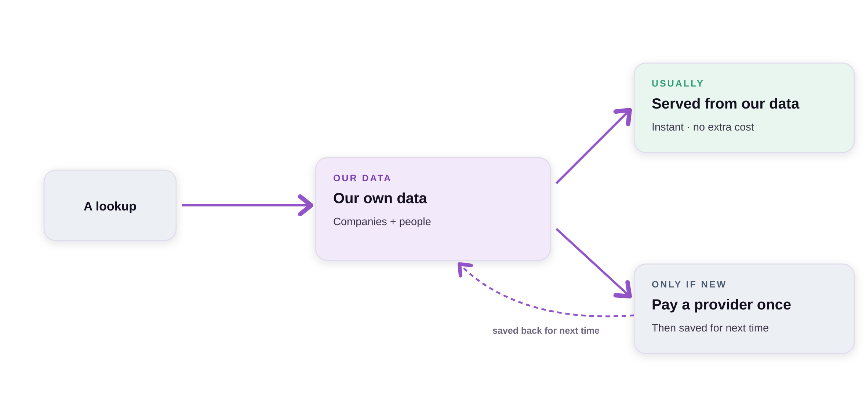
JULY 2026
THEME 03
Own our data
1
One source of truth
A single, trusted record of every company and person we touch.
2
Pay only for what's new
We serve from our own data first and only pay for genuinely new information.
Serve from our own data first, and pay an outside provider only when something is genuinely new.
3
A compounding asset
What we learn is kept and reused, so cost stops climbing with usage.
AgencyCore · Product Roadmap · June 2026
13

Slide 14
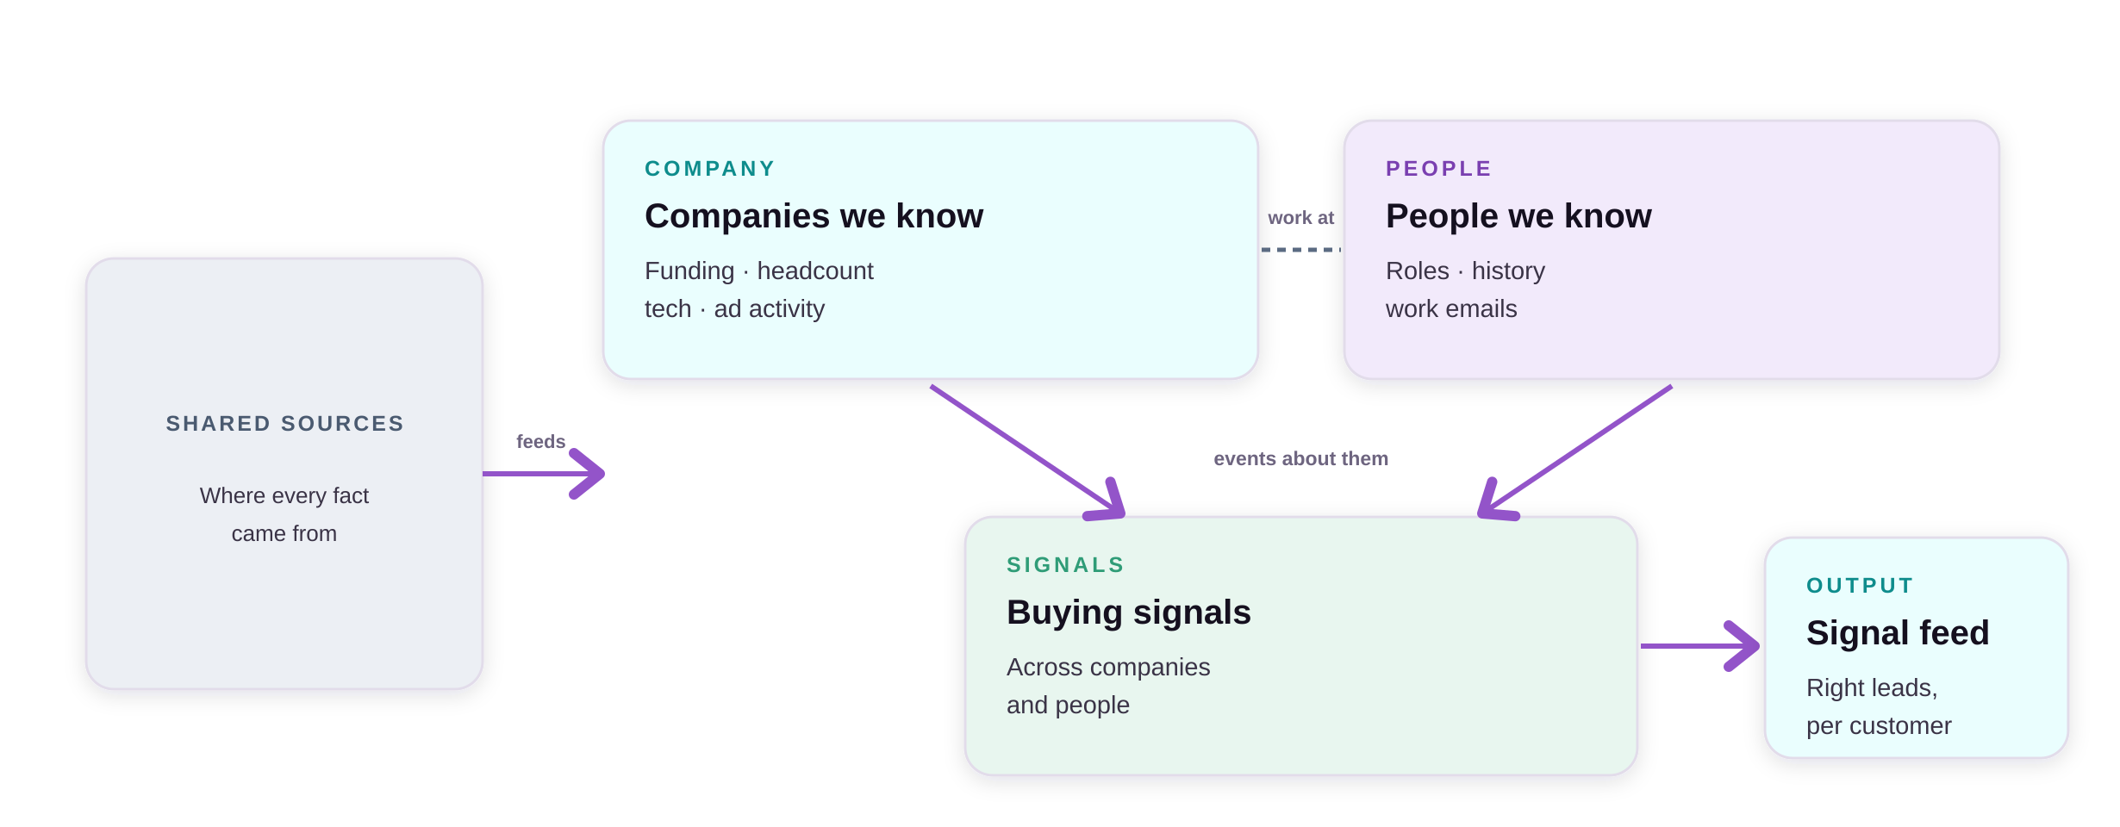
THEME 03 · OUR DATA ASSET
Our intelligence databases
Three connected databases build one compounding view of every company and person, and surface the right leads to each customer.
AgencyCore · Product Roadmap · June 2026
14

Slide 15
04
THEME 04 · Later · AUGUST 2026
New features and workflows
With a dependable foundation and our own data in place, we shift from fixing to building, launching new product features and automations far faster.
Compounding
returns on the foundation each new capability is faster to build than the last
AgencyCore · Product Roadmap · June 2026
15

Slide 16
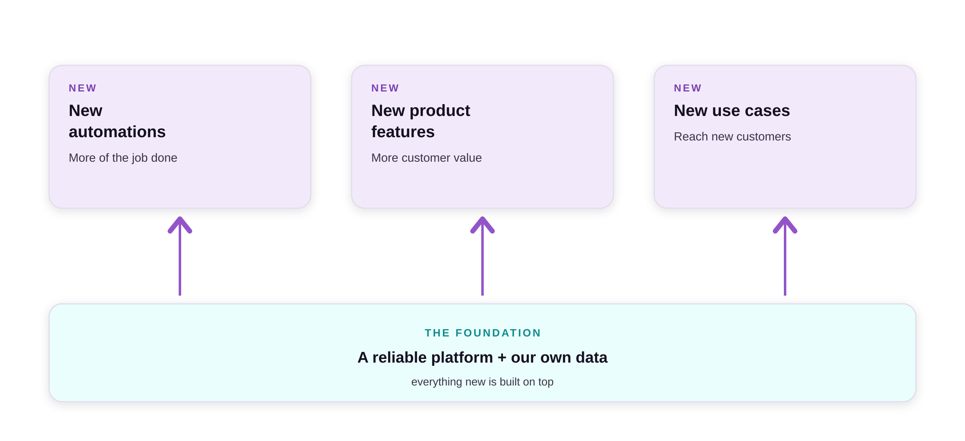
AUGUST 2026
THEME 04
New features and workflows
1
New automations
New workflows that handle more of the customer's job, end to end.
2
Accurate from day one
Every new capability draws on our own data, so it's accurate from the start.
Everything new is built on the foundation and our own data, so each capability ships faster than the last.
3
Faster to launch
A dependable foundation takes new features from idea to launch quickly.
AgencyCore · Product Roadmap · June 2026
16

Slide 17
LOOKING AHEAD · ON THE FOUNDATION
GTM agents we could build next
With the foundation and our own data, we can build a whole team of go-to-market agents.
AI
AI SDR
AI
Personalized outreach
AI
Signal-based plays
Find and qualify target accounts and contacts, around the clock.
Craft tailored messages across email and LinkedIn.
Reach out the moment a buying signal fires.
AI
Account research
AI
Inbound qualifier
AI
Meeting booker
Deep-dive on every account before the conversation.
Qualify and route inbound leads instantly.
Handle replies and book meetings automatically.
All powered by the AgencyCore foundation and our own intelligence data.
AgencyCore · Product Roadmap · June 2026
17

Slide 18
THE THROUGH-LINE
One move unlocks the rest
1
2
3
4
Stronger product
Better results
Own our data
Build & expand
June · the foundation
June · quality + coverage
July · stop re-buying data
August · new features
Foundation first.
June lays the foundation and lifts quality, July gives us our own data, and August builds new features and workflows on top. Each month builds on the last.
AgencyCore · Product Roadmap · June 2026
18

